Slide 1
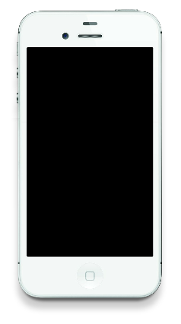

Best Mobile Phone Power Point Template Android
VS
Samsung
Step 01
Step 03
IPhone
It is a long established fact that a reader
It is a long established fact that a reader
Step 02
Step 04
It is a long established fact that a reader
It is a long established fact that a reader
60%
Step 01
60%
Step 02
It is a long established fact that a reader
It is a long established fact that a reader
Title 01
IPhone

